Slide 1
Performance Metric

Slide 2
Evaluation Metric/ Performance Measurement
The loss function shows a measure of model performance during model training.
Evaluation Metrics are used to judge and measure model performance after training.

Slide 3
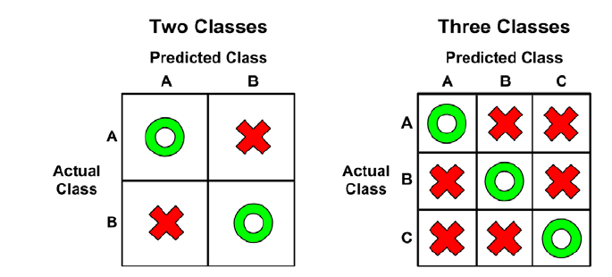
Performance Measurement
A confusion matrix is a table that categorizes predictions according to whether they match the actual value in the data.
When the predicted value is the same as the actual value, this is a correct classification. Correct predictions fall on the diagonal in the confusion matrix (denoted by O).
The off-diagonal matrix cells (denoted by X) indicate the cases where the predicted value differs from the actual value. These are incorrect predictions.

Slide 4
from sklearn.metrics import confusion_matrix
y_true = [2, 0, 2, 2, 0, 1]
y_pred = [0, 0, 2, 2, 0, 2]
confusion_matrix(y_true, y_pred)
array([[2, 0, 0],
[0, 0, 1],
[1, 0, 2]])
Actual\Predicted | Class 0 | Class 1 | Class 2 | Total
Class 0 | 2 | 0 | 0 | 2
Class 1 | 0 | 0 | 1 | 1
Class 2 | 1 | 0 | 2 | 3
Total | 3 | 0 | 3 | 6

Slide 5

Accuracy score
Accuracy is a metric that summarizes the performance of a model. classification : it is the number of correctly predicted data points out of all the data points.
import numpy as np
from sklearn.metrics import accuracy_score
y_pred = [0, 2, 1, 3]
y_true = [0, 1, 2, 3]
accuracy_score(y_true, y_pred)
0.5

Slide 6
Class Importance
When one class is more important than other class, accuracy score is always not the right Measurement
Example : 1)prediction of cancer, here we cannot predict not cancer patients as cancer patient, loss will be really high, 2) Prediction for motor failure: we cannot predict fail motor as pass motor, loss will be high
In this cases we use metrics like : Precision, recall, F1-Score
Precision: What proportion of predicted selected class (cancer class, fail class) are identified correctly?
Recall: What proportion of actual selected class are identified correctly?
F1 score is harmonic mean of precision and Recall.

Slide 7
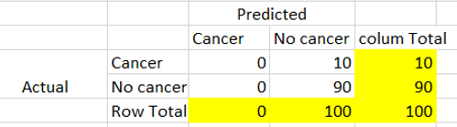
Suppose we have 100 patients and 10 have cancer and remaining non cancer.
We have predicted all patients as no cancer patient.
Accuracy = (0+90)/100 = 0.9
Precision for cancer class = 0/(0+0) =0 # out of predicted cancer how many are correct
Recall for cancer class = 0/(0+10) = 0 # out of actual cancer how many are correct
F1 score =0
Our class cation model is not working for cancer patients even though we have 90% model accuracy

Slide 8
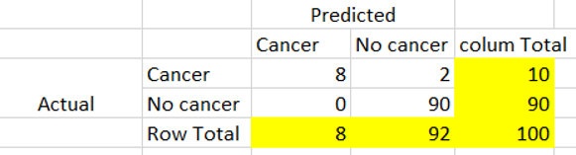
Suppose we have 100 patients and 10 have cancer and remaining non cancer.
We have predicted 8 patients correctly as cancer patient and remaining no cancer patient.
Accuracy = (8+90)/100 = 0.98
Precision for cancer class = 8/(8+0) =1 # out of predicted cancer how many are correct
Recall for cancer class = 8/(8+2) = 0.8 # out of actual cancer how many are correct
F1 score = 2*(1*0.8)/(1+0.8) = 0.88
Now classfication model is working for cancer patients, so high accuracy doesn’t always guarantee good model need to observe precision and recall for important class

Slide 9
1)prediction of cancer, here we cannot predict not cancer patients as cancer patient, loss will be really high,
2) Prediction for motor failure: we cannot predict fail motor as pass motor, loss will be high
Where loss is really high, we decrease the threshold that mean we should have high recall, predicted actual out of total actual, should not miss any actual cancer patient. It is okay to predict non cancer patient as cancer patients.

Slide 10
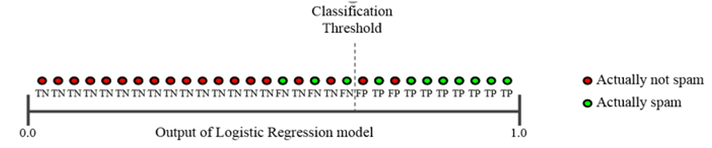
Classification Threshold
Precision and recall can change according to classification threshold
We need to trade off b/w precision and recall. That is, improving precision typically reduces recall and vice versa.
Here if we increase the classification threshold, actually spam class precision will increase as out of total predicted spam all be correct.
Vice versa recall will decrease as out of total actual spam we are able to predict less

Slide 11
Classification Threshold
Here if we decrease the classification threshold, actually spam class recall will increase as out of total actual spam all able to predict.
Vice versa precision will decrease as now some not spam also getting classified as spam.

Slide 12
As I have explained before it depends on the problem in hand to decide which on to maximize. Here are few sample examples which will give you an idea:
Covid positive detection — Health authorities cannot afford to have any person to roam around freely with the virus in her body. In other words, a model cannot afford to falsely detect a person healthy (FN=0)while she is carrying the virus. The target here is to minimize FN which means we need to maximize Recall.
Spam Filtering — While tagging emails as spam, we need to make sure that no valid emails are being tagged as spam because the user may lose some important communication. Here, our goal is to minimize the FP ie., maximize Precision.
Fraudulent Transaction — Using similar logic, a bank cannot afford to allow any fraudulent transactions through its security gateway ie., minimize FN. For bank it still alright if a few valid transactions are flagged as fraudulent. Again, higher Recall.

Slide 13
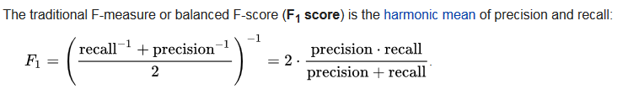
F1- Score
As precision and Recall are threshold dependent, we use single metric to combine both precision and recall.
We select classification threshold for which F1 score is maximum.

Slide 14
Classification Report
Using the classification report module in python we can get all performance metrics.
Precision
Recall
F-score
Support for each class
Total accuracy
Macro and weighted precision, recall, f1 score

Slide 15
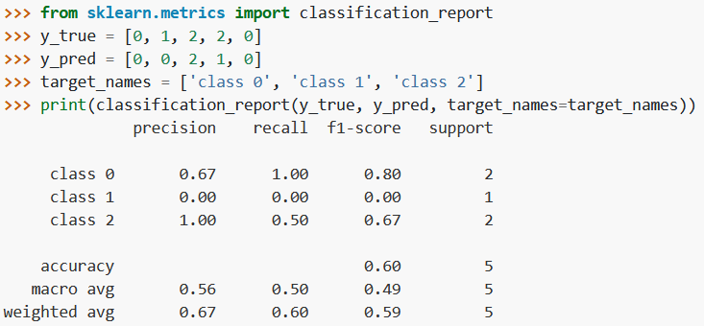
Actual\Predicted | Class 0 | Class 1 | Class 2 | Total
Class 0 | 2 | 0 | 0 | 2
Class 1 | 1 | 0 | 0 | 1
Class 2 | 0 | 1 | 1 | 2
Total | 3 | 1 | 1 | 5
Actual | Precision | Recall
Class 0 | 2/3 | 2/2
Class 1 | 0/1 | 0/1
Class 2 | 1/1 | 1/2
Macro avg(balanced calculation) for precision = (0.67+0.00+1)/3 = 0.56
weighted avg(balanced calculation) for precision = (0.67*2+0.00+1*2)/5 =0.67

Slide 16
Balanced Accuracy
When Both the class or all class are equally important accuracy, precision and recall are not enough specially in case of class imbalance
We use balanced accuracy, Average of recall scores per class. The best value is 1 and the worst value is 0
for balanced datasets, the balance accuracy is equal to accuracy.
When 2 classes, Balanced accuracy = (Recall(Class 1)+ Recall(class 2))/2
When 3 classes, Balanced accuracy=
(Recall(Class 1)+ Recall(class 2)+Recall(class 3))/3
In classification report in recall column balanced accuracy and weighted accuracy can be seen

Slide 17
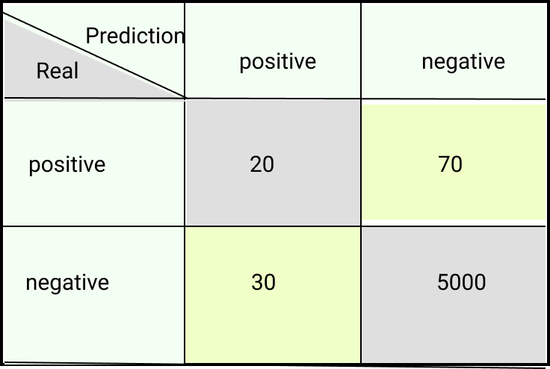
Sensitivity : Recall for positive class
= Correct Predicted positive/ Total Real Positives
= 20/(20+70) = 0.22 ~ 22%
Specificity : Recall for negative class
= correct predicted negative/ Total Real Negatives
= 5000/ (30+5000)
= 0.994 ~99%
Balanced Accuracy = (Sensitivity + Specificity) / 2 = 22.2 + 99.4 / 2 = 60.80%
Accuracy = (20+5000)/(5000+20+70+30)= 5020/ 5120 = 0.98 = 98%
This makes the score lower than what accuracy predicts as it gives the same weight to both classes.

Slide 18
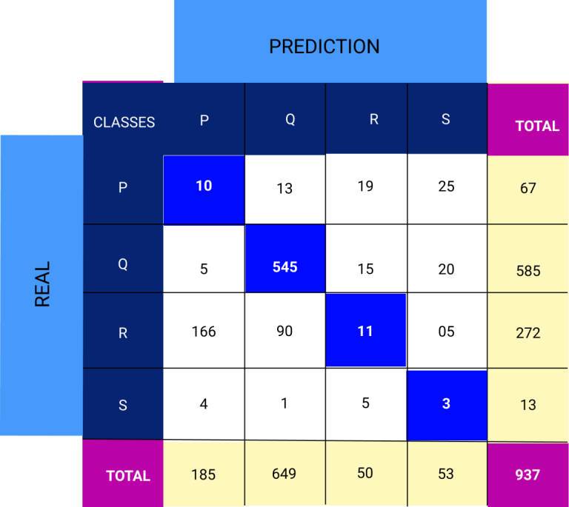
Class P Recall = 10/67 = 14.9 %
Class Q recall= 545/585 = 93.1 %
Class R Recall = 11/272 = 4%
Class S Recall = 3/13 = 23%
Balanced Accuracy = (14.9+93.1+4+23)/4 = 33.7 %
Accuracy = (10+545+11+3)/937 = 60.7%
from sklearn.metrics import balanced_accuracy_score
bal_acc= balanced_accuracy_score(test_data['Outcome'], model.predict(X_test) )
https://neptune.ai/blog/balanced-accuracy

Slide 19
Balanced Accuracy vs F1 Score
F1 keeps the balance between precision and recall, and specific for one class
F1 = 2 * ([precision * recall] / [precision + recall])
When all classes are equally important, and we have balanced data, normal accuracy is enough
When all classes are equally important, and we have imbalance data, balance accuracy is better measurement
F1 is a great scoring metric for both balance and imbalanced data when more attention is needed on the one class.

Slide 20
Model Selection

Slide 21
Model Selection
Always get the question
Which model/algorithm is the best?
Which model is robust/reliable with accuracy or structure, parameter weights?
Which model is interpretable?
We can get multiple models even for same algorithm with
Variation in training data
Change in hyperparameters, parameter grid

Slide 22
Train &Test data
Suppose that we have clinical measurements (e.g., weight, blood pressure, height, age, family history of disease) for several patients, as well as information about whether each patient has diabetes.
We can use these patients' data to train a model and predict risk of diabetes based on clinical measurements.
In practice, we want this method to accurately predict diabetes risk for future patients based on their clinical measurements. We are not very interested in train data, since we already know which of those patients have diabetes.
Due to this, we always divide whole data into train and test

Slide 23
Train &Test data
We can keep some percentage of train data for testing,
80% for training, and 20% for testing.
90% for training, and 10% for testing…..
# Split in train and test data
from sklearn.model_selection import train_test_split
train_data, test_data= train_test_split(data, test_size=0.25, random_state= 123)
X_train, X_test, y_train, y_test = train_test_split( X, y, test_size=0.4, random_state=0)
Train_test_split randomly divides data in to testing and training.
We fix the random_state to avoid the random variation each time.

Slide 24
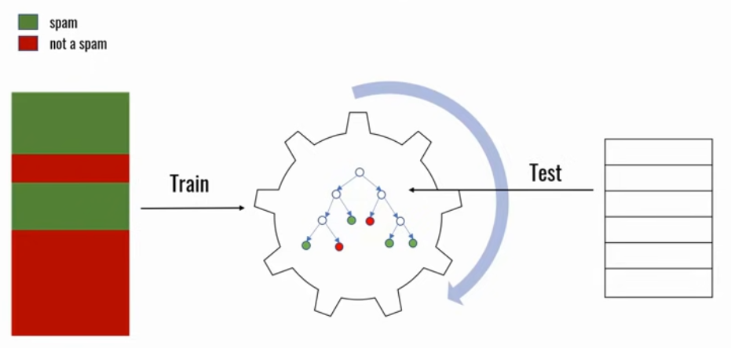

Slide 25
Test data problems
Sometimes while dividing the data into train and test split we might be lucky all good data will be test data, and model be biased towards one test data.
But it will perform poorly on new set of test data
Also the test data might be completely different from train data
What if we don’t have enough data to set aside a test dataset?
Cross-Validation:
Each data point is used both as train and test data.

Slide 26
When evaluating different settings (“hyperparameters”) for estimators, such as the C setting that must be manually set for an SVM, there is still a risk of overfitting on the test set because the parameters can be tweaked until the estimator performs optimally.
This way, knowledge about the test set can “leak” into the model and evaluation metrics no longer report on generalization performance.
To solve this problem, yet another part of the dataset can be held out as a so-called “validation set”: training proceeds on the training set, after which evaluation is done on the validation set, and when the experiment seems to be successful, final evaluation can be done on the test set.

Slide 27
However, by partitioning the available data into three sets, we drastically reduce the number of samples which can be used for learning the model, and the results can depend on a particular random choice for the pair of (train, validation) sets.
A solution to this problem is a procedure called cross-validation (CV for short). A test set should still be held out for final evaluation.
In the basic approach, called k-fold CV, the training set is split into k smaller sets (other approaches are described below, but generally follow the same principles).
https://scikit-learn.org/stable/modules/cross_validation.html

Slide 28
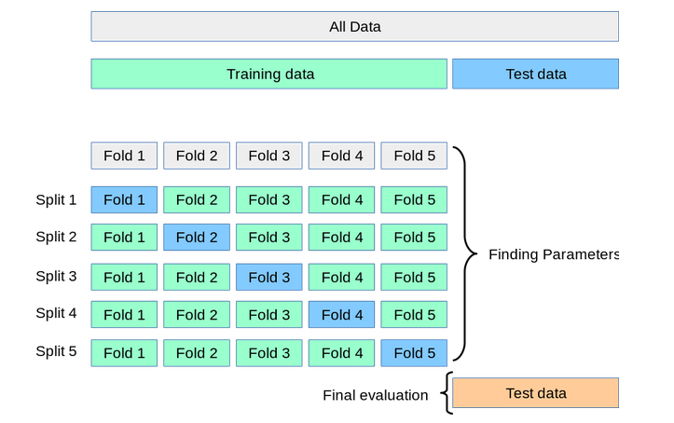

Slide 29
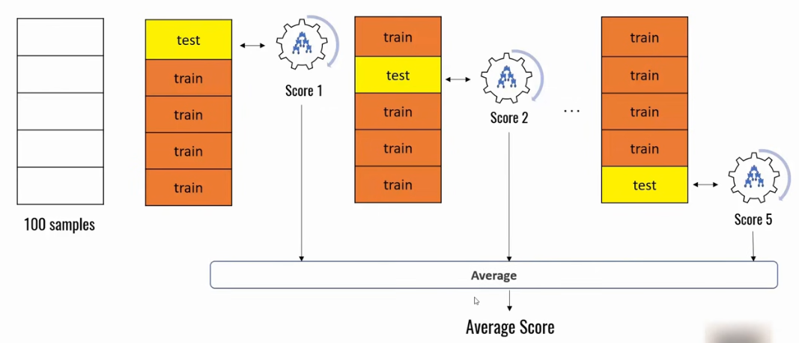
K fold Cross validation
Here we divide data in 5 parts (k=5) and build 5 models keeping one part separate , and accuracy from all models will be averaged to get model performance.

Slide 30
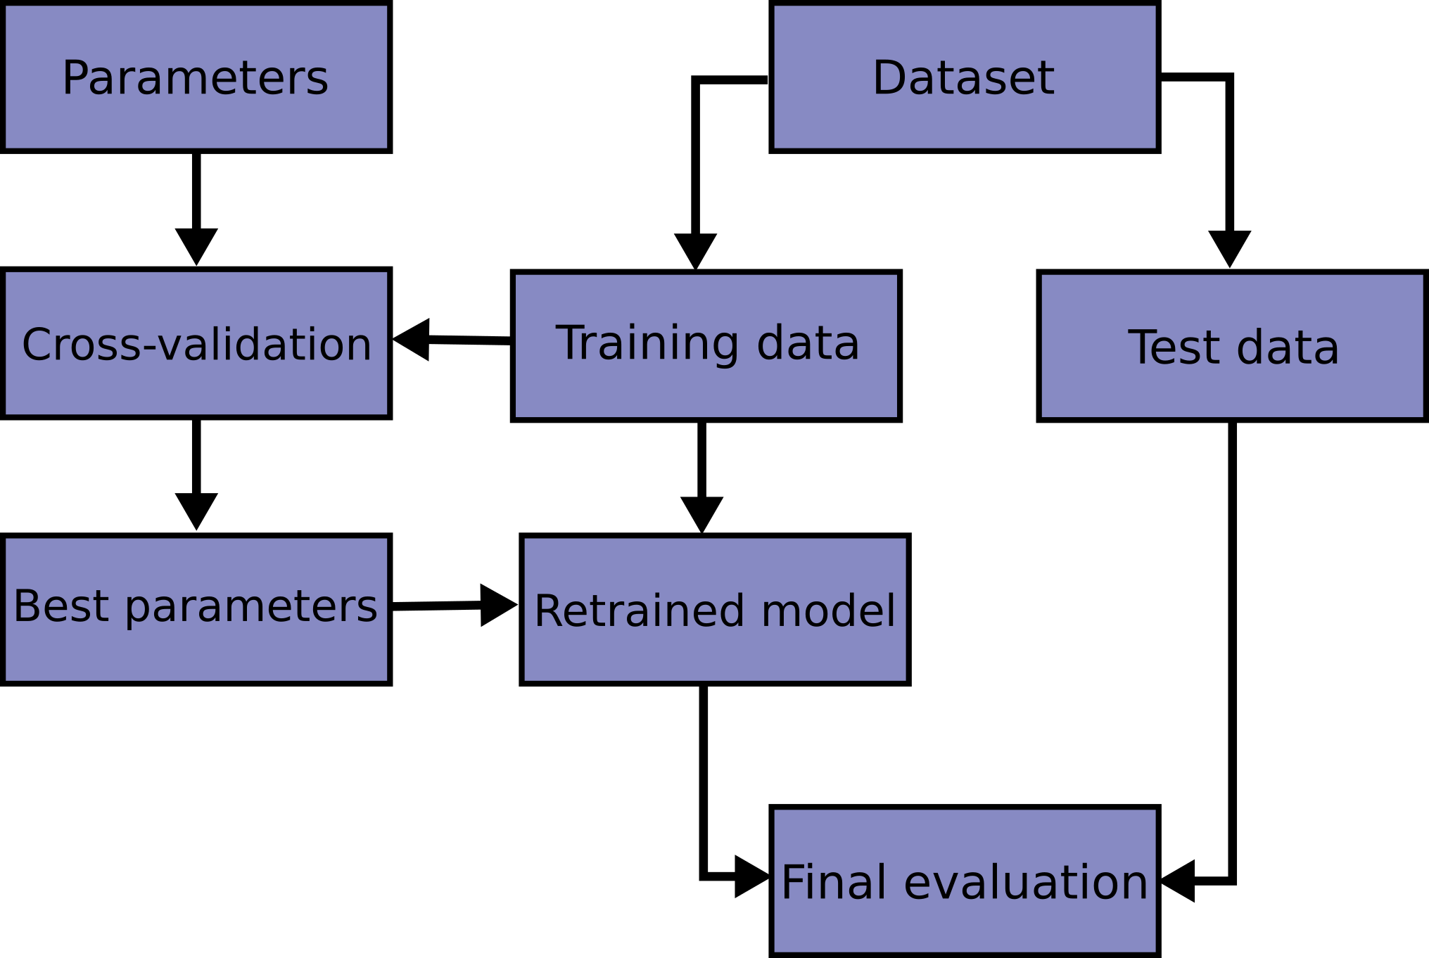

Slide 31
Python Implementation
from sklearn.model_selection import cross_val_score
model = tree.DecisionTreeClassifier(max_depth=4, random_state=42)
cross_val_score(model, X_train, Y_train, cv=3)
Note: In the code above, the function of the argument n_jobs = -1 is to train multiple decision trees parallelly.
Tutorial from Code Basics
https://www.youtube.com/watch?v=gJo0uNL-5Qw

Slide 32
By default, the score computed at each CV iteration is the score method of the estimator. It is possible to change this by using the scoring parameter:
from sklearn import metrics
scores = cross_val_score(clf, X, y, cv=5, scoring='f1_macro')
scores

Slide 33
When the cv argument is an integer, cross_val_score uses the KFold or StratifiedKFold strategies by default
from sklearn.model_selection import ShuffleSplit
cv = ShuffleSplit(n_splits=5, test_size=0.3, random_state=0)
cross_val_score(clf, X, y, cv=cv)
ShuffleSplit: shuffing the data and divide into train and test. This random splits do not guarantee that all folds will be different

Slide 34
Stratified Sampling
Some classification problems can exhibit a large imbalance in the distribution of the target classes: for instance there could be several times more negative samples than positive samples.
In such cases it is recommended to use stratified sampling as implemented in StratifiedKFold and StratifiedShuffleSplit to ensure that relative class frequencies is approximately preserved in each train and validation fold
Stratified Sampling is a sampling technique used to obtain samples that best represent the population. It reduces bias in selecting samples by dividing the population into homogeneous subgroups called strata, and randomly sampling data from each stratum(singular form of strata).

Slide 35
from sklearn.model_selection import StratifiedKFold, KFold
skf = StratifiedKFold(n_splits=3)
cross_val_score(clf, X, y, cv=skf)

Slide 36
Problem K-fold cross validation :
When it divides data into folds, doesn’t care about the class distribution
It might happen in one-fold 1 class 0 data is present and in fold 2 class 1 is present
Also it sequentially divides the data in fold, not randomly if data is arranaged from 0 to 1, folds will not have same distribution of training data.
Stratified K-fold cross validation : It maintains the class distribution of each category in each fold
from sklearn.model_selection import StratifiedKFold
folds = StratifiedKFold(n_splits=3)

Slide 37
The cross_validate function and multiple metric evaluation
The cross_validate function differs from cross_val_score in two ways:
It allows specifying multiple metrics for evaluation.
It returns a dict containing fit-times, score-times (and optionally training scores, fitted estimators, train-test split indices) in addition to the test score.
from sklearn.model_selection import cross_validate
from sklearn.metrics import recall_score
scoring = ['precision_macro', 'recall_macro']
clf = svm.SVC(kernel='linear', C=1, random_state=0)
scores = cross_validate(clf, X, y, scoring=scoring)
sorted(scores.keys())
['fit_time', 'score_time', 'test_precision_macro', 'test_recall_macro']
scores['test_recall_macro']

Slide 38
Time Series Split
TimeSeriesSplit is a variation of k-fold which returns first k folds as train set and the k+1 fold as test set. Note that unlike standard cross-validation methods, successive training sets are supersets of those that come before them. Also, it adds all surplus data to the first training partition, which is always used to train the model.
This class can be used to cross-validate time series data samples that are observed at fixed time intervals.

Slide 39
from sklearn.model_selection import TimeSeriesSplit
X = np.array([[1, 2], [3, 4], [1, 2], [3, 4], [1, 2], [3, 4]])
y = np.array([1, 2, 3, 4, 5, 6])
tscv = TimeSeriesSplit(n_splits=3)
print(tscv)
TimeSeriesSplit(gap=0, max_train_size=None, n_splits=3, test_size=None)
for train, test in tscv.split(X):
print("%s %s" % (train, test))
[0 1 2] [3]
[0 1 2 3] [4]
[0 1 2 3 4] [5]

Slide 40
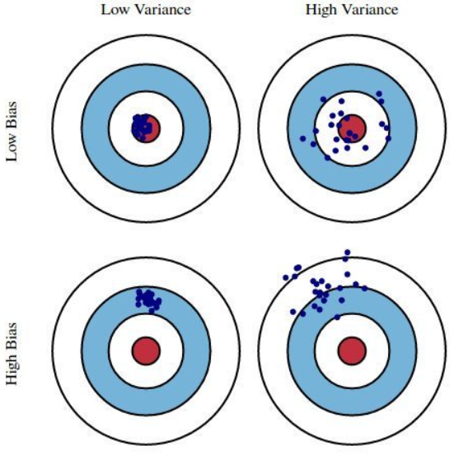
Bias-Variance
Bias : Refers to training data error.
Variance: Refers to the variance in test data predictions, prediction of single test point also varies with small change in training data set.
Circle represents the train data error regions and dots are predictions.
Low Bias, high variance: Overfitting
High bias, low variance: Underfitting
Optimal model : Low Bias and low variance means train and test error both less

Slide 41
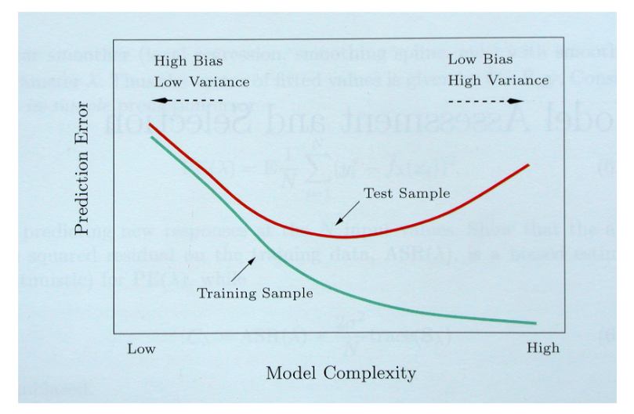

Slide 42
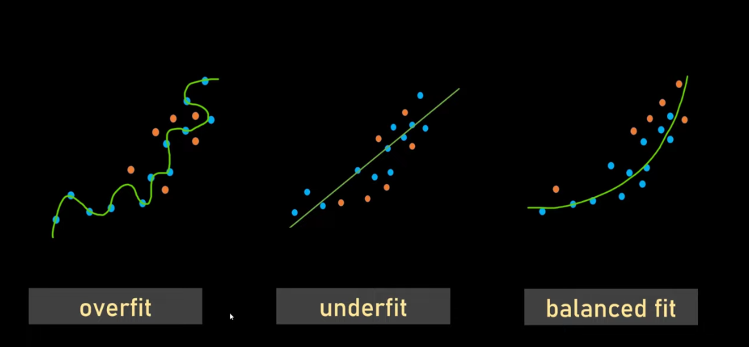

Slide 43
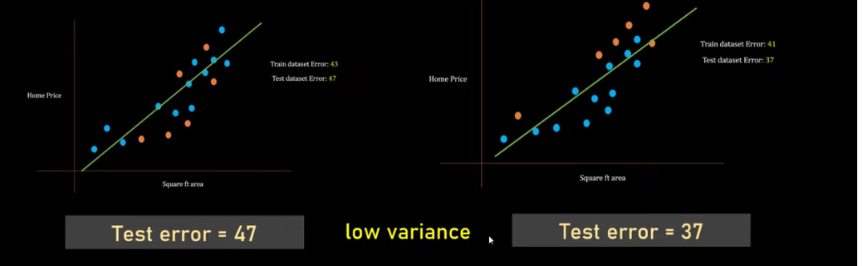

Slide 44
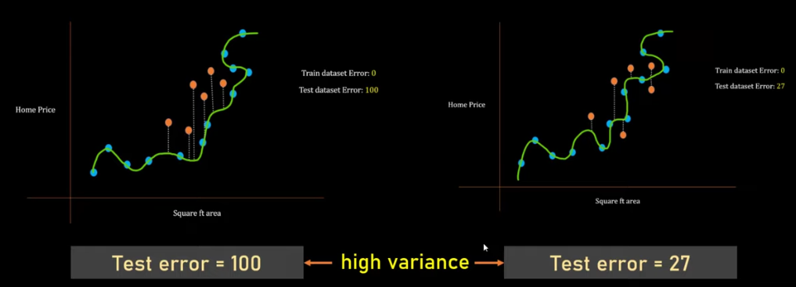
When the model is overfitting, it has high variance.
To handle high variance case , we can use ensemble model

Slide 45
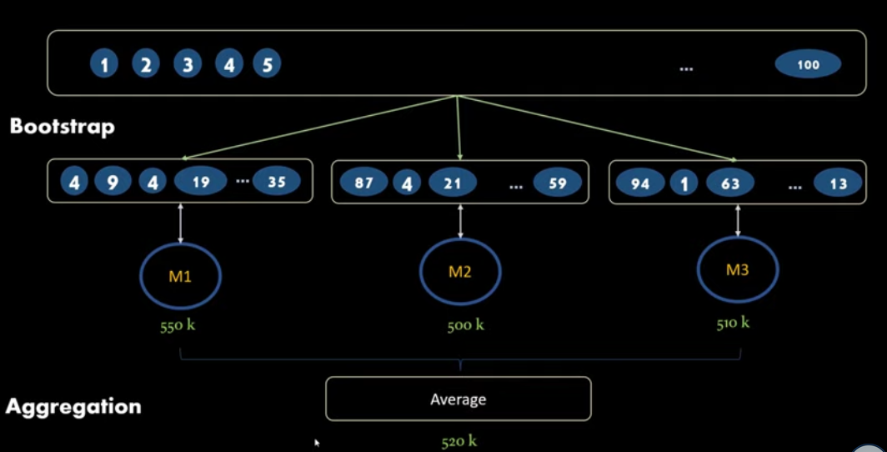
Ensemble : Sampling with Replacment

Slide 46
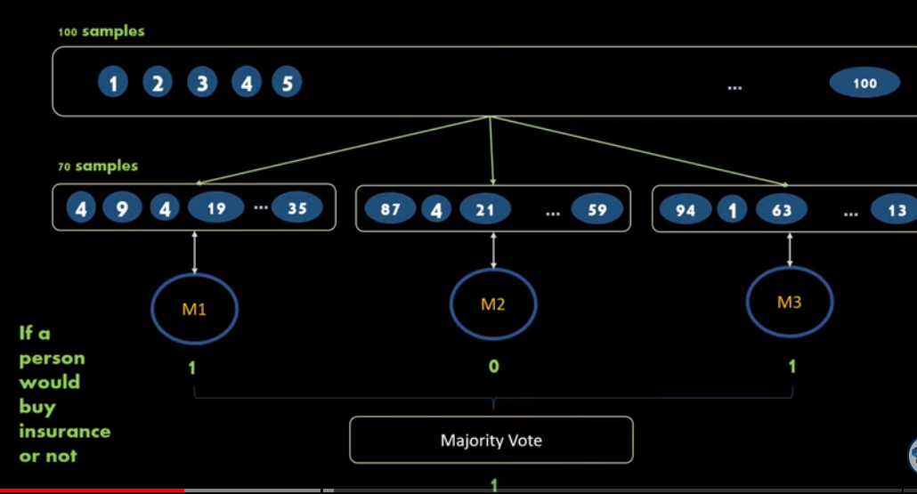
https://www.youtube.com/watch?v=RtrBtAKwcxQ

Slide 47
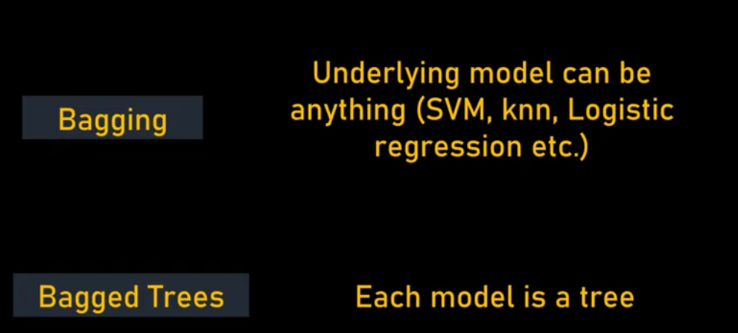
Individual models are weak learners, individual model when combined we get better result

Slide 48
from sklearn.ensemble import BaggingClassifier
bag_model = BaggingClassifier(
base_estimator=DecisionTreeClassifier(),
n_estimators=100,
max_samples=0.8,
oob_score=True,
random_state=0
)
bag_model.fit(X_train, y_train)
bag_model.oob_score_

Slide 49
from sklearn.svm import SVR
from sklearn.ensemble import BaggingRegressor
regr = BaggingRegressor(estimator=SVR(),
n_estimators=10, random_state=0).fit(X, y)
regr.predict([[0, 0, 0, 0]])

Slide 50
sklearn.model_selection.GridSearchCV
Exhaustive search over specified parameter values for an estimator.
https://scikit-learn.org/stable/modules/grid_search.html#grid-search

Slide 51
Grid Search
from sklearn.metrics import balanced_accuracy_score
bal_acc= balanced_accuracy_score(test_data['Outcome'], model.predict(X_test) )
Balanced accuracy can be specified in Cross validation and Grid Search
from sklearn.model_selection import cross_val_score
cross_val_score(model, X_train, Y_train, cv=3,scoring= 'balanced_accuracy’)
from sklearn.model_selection import GridSearchCV
param_grid={'max_depth': [3,4,5], 'min_samples_split': [0.10,0.20, 0.25],
'min_impurity_decrease':[0.01,0.02]}
grid_model = GridSearchCV(tree.DecisionTreeClassifier(class_weight= 'balanced',random_state= 1), param_grid,cv=3, return_train_score=False,scoring= 'balanced_accuracy')

Slide 52
The scoring parameter: defining model evaluation rules
Model selection and evaluation using tools, such as model_selection.GridSearchCV and model_selection.cross_val_score, take a scoring parameter that controls what metric they apply to the estimators evaluated.
The table in Sklearn documentation shows all possible values.
https://scikit-learn.org/stable/modules/model_evaluation.html

Slide 53
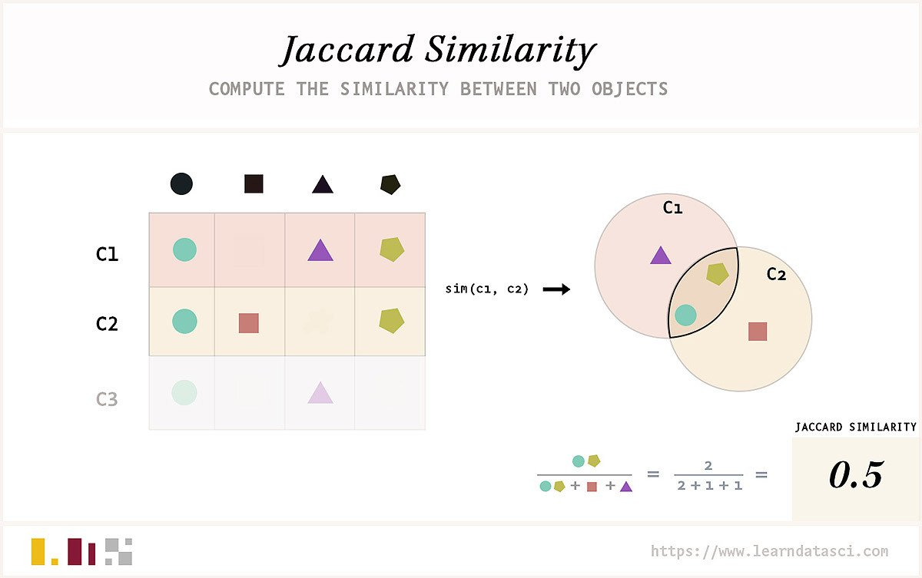
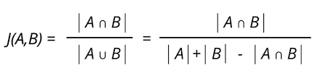

Slide 54
DaTa Transformation
https://scikit-learn.org/stable/data_transforms.html#data-transforms

